Slide 1
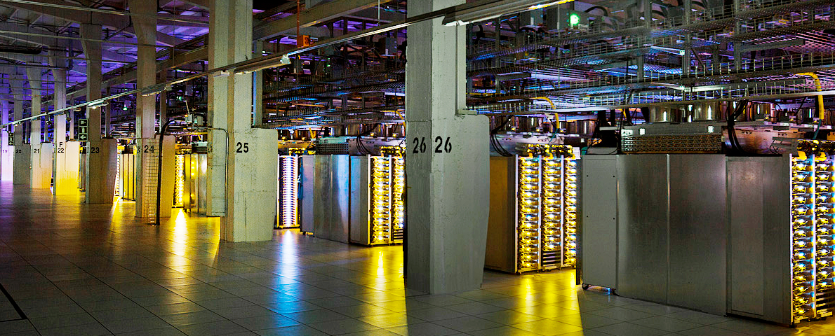


Data Driven Software Releases
Yovka Pencheva, Concur Cloud Services

Slide 2
Agenda
Traditional test and release practice, ice-cream cone anti-pattern
Test the right way, Continuous delivery, Continuous deployment
Blue-Green deployments, Canary deployments
Testing in Production
Passive monitoring (data driven quality, application performance monitoring)
Experiments in production (A/B testing, controlled test flights)
Dogfooding
Active monitoring (synthetic transactions)
System resilience testing (load testing, destructive testing), Netflix monkeys army
Concur Cloud Logging Services

Slide 3
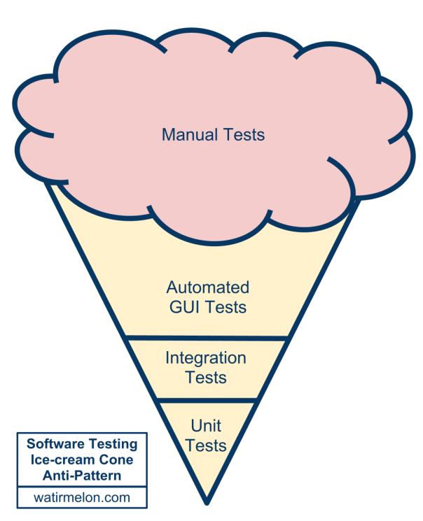
Traditional Testing
Lots of manual testing before each release, QE sign-offs
mini waterfall process, release once in 4 weeks in best case
Majority of automated tests on UI/end-to-end level
deal with lots of flakiness and false positives
many times SDETs shoot themselves in the feet
Automated tests on API level
most of time these are missing
Unit tests
usually less coverage than UI tests
Classic software testing ice-cream cone anti-pattern

Slide 4
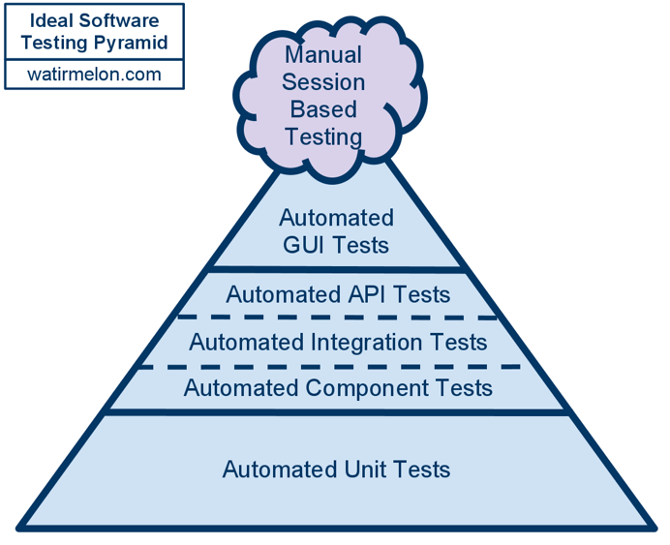
Software Testing the Right Way
No single rule, no “silver bullet”
push as much as possible automation testing to lower test levels
analyze why bugs and regressions “passed” through automation and fill gap
Unit tests
test just a method or class, all interactions mocked
very fast and reliable, first feedback on each commit
Integration/API tests
integration different units and components
increased confidence when pass
UI/End-to-end system tests
test the system end-to-end
what users see, however the slowest and flakiest layer
Manual testing, bug-bashes

Slide 5
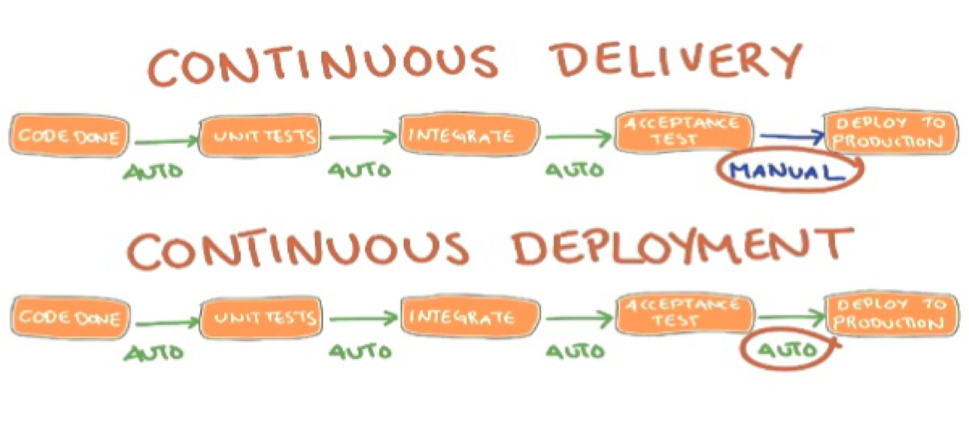
Continuous Delivery Continuous Deployment
Notes:
Continuous delivery – at any moment you have a build ready to be released, but decision and deployment to production is a manual action, testing on all levels happens in pre-production (lab) environment, stops with deployment to production
Continuous deployment – fully automated deployment to production, testing continue even after deployment to production

Slide 6
What Happens Once We Release?
Notes:
Users do something completely different from what we have tested
System and Ops engineers fix things in panic mode, leads to complete mess in production environment
We are paged/called that system is down and no users can use the service, damaged reputation of company, unhappy users, SLA penalties, lost customers and revenues

Slide 7
Twist to Testing in Production
Dev Testing
Testing in Lab
Pre-prod
Testing
Prod
Dev Testing
Lab
Pre-prod
Testing
Production
Notes:
Big companies twist testing from lab (pre-production) testing to production testing
Netflix for example test ONLY in production
Requires data-driven culture, tons of instrumentation and monitoring

Slide 8
Blue-Green Deployment
Two identical environments (Blue and Green), running different release versions
At any time only one environment serves production traffic
Test and monitor in Production, switch when confident and ready
Minimize downtime and risk
Notes:
Data-driven decisions if to rollback or rollout

Slide 9
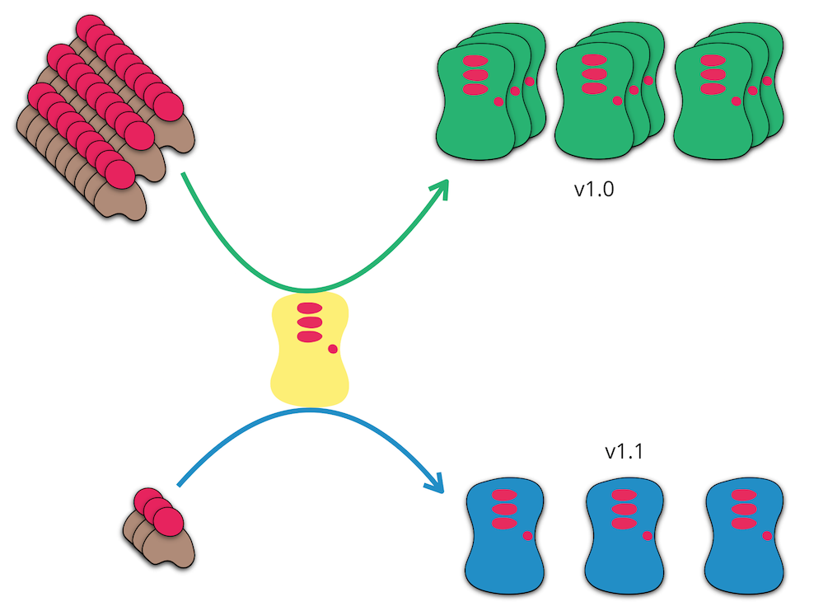
Canary Deployment
Start same way as Blue-Green deployment
Route few selected users to new deployment
Test and monitor in Production for regressions
Incremental (data-driven), controlled rollout
Notes:
Data-driven decisions if to rollback or rollout

Slide 10
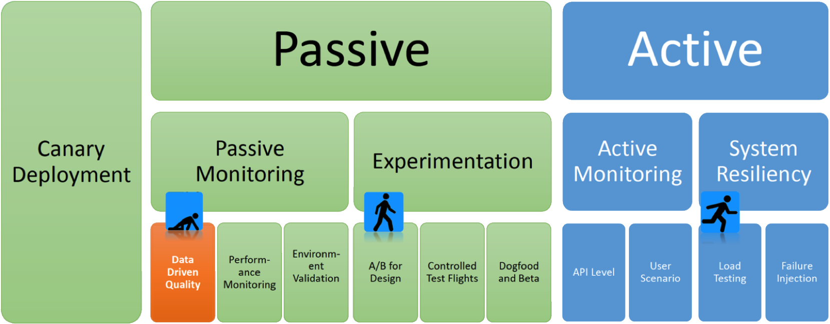
Testing in Production

Slide 11
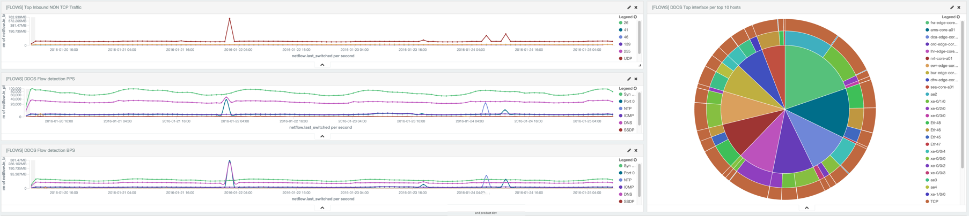
Passive Monitoring
Monitor application performance in production and react quickly
Monitor to understand your customers use cases
Data-driven quality engineering and product development
prioritize testing, bugs fixes and features based on real data and facts

Slide 12
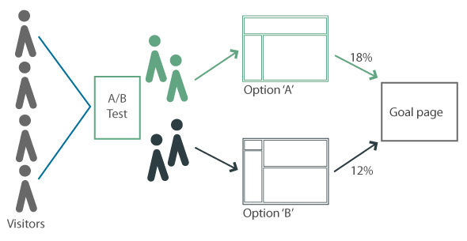
A/B Testing (Experiments) Test the Idea First
Notes:
A/B testing is a term for a randomized experiment with two variants, A and B, which are the control and variation in the controlled experiment.
A/B experiments are entirely data-driven.

Slide 13
Dogfooding
Eat your own dog food (popularized by Microsoft)
the company uses latest stable build of its own products/services
Bug bashes and long haul testing on dogfood builds
Data metrics analysis and comparisons between released and dogfood builds
Fishfooding (invented by Google)
always live on bleeding edge
development organization uses latest unstable build of its own product/service
you commit crap, you use your crap immediately

Slide 14
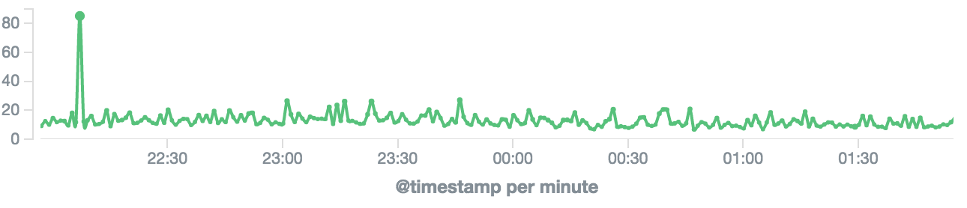
Active Monitoring
Simulate user actions in production all the time – synthetic transactions
Usually on API Level

Slide 15

System Resiliency
Destructive Testing in Production
Netflix Simian Army
Latency Monkey
Chaos Monkey
Chaos Gorilla
Chaos Kong
Load Testing in Production
Notes:
Netflix Simian Army is open sourced and available at https://github.com/Netflix/SimianArmy
Destructive testing can be only data-driven testing in production

Slide 16
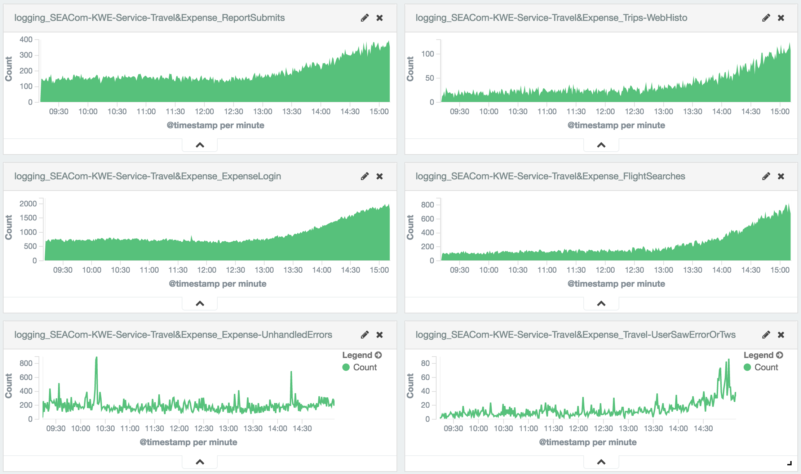
Concur Cloud Logging Services
Logging as a Service
Release monitoring and validation
Application performance monitoring
Automated alerting
A/B experiments
Synthetic tests monitoring
More..

Slide 17
References
https://github.com/ypencheva/continuous_deployment
Software testing levels and testing types
Continuous Delivery book
MartinFowler.com

Slide 18
Thank You!
Email: Yovka.Pencheva@concur.com
LinkedIn: www.linkedin.com/in/ypencheva

